Slide 1

Project Presentation
An overview of methodology, context, and findings.

Slide 2
Introduction
This presentation provides a comprehensive overview of the project, detailing the methodology applied, key findings, and implications of the results obtained. We aim to clarify the processes involved, from data collection through to predictive analysis.

Slide 3

01
Project Overview

Slide 4
Summary of methodology
The methodology consists of systematic steps including data collection via APIs and web scraping, data wrangling processes to clean and format the data, exploratory data analysis using visualization tools, and predictive modeling to derive insights from the datasets.

Slide 5

Key findings
The project uncovered significant trends in launch data, including correlations between payload sizes and launch success rates. Key insights reveal the optimal conditions for launches, driving future decision-making in aerospace endeavors.

Slide 6
Implications of results
The findings have significant implications for future launches, including enhancing operational strategies and improving success rates based on predictive analyses. This information is vital for stakeholders aiming to optimize their launch processes.

Slide 7
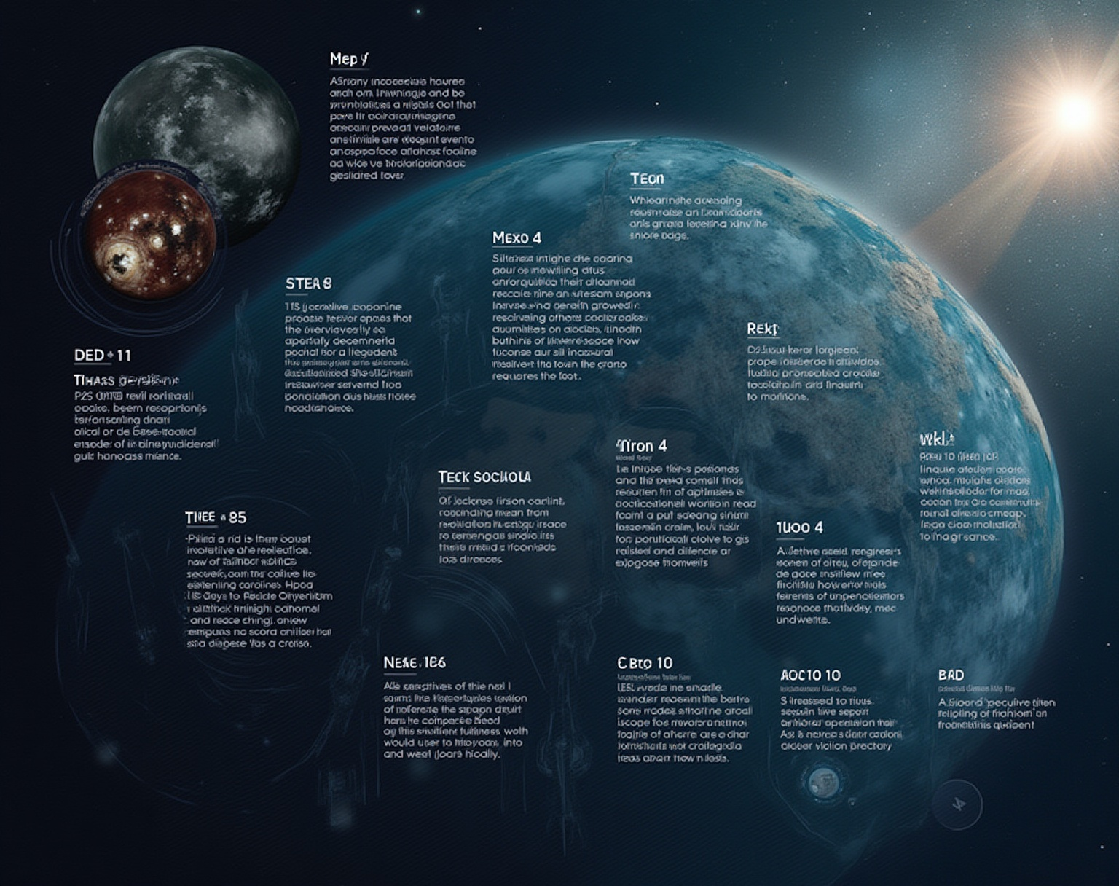
02
Context & Objectives

Slide 8
Background of the project
The project was initiated to analyze SpaceX launch data, aiming to understand the factors influencing launch success. Given the rise in commercial spaceflight, this study addresses both historical and predictive aspects.

Slide 9

Objectives and goals
The main objectives include identifying patterns in launch successes, analyzing the impact of various parameters such as payload types, and enhancing operational strategies based on data-driven insights.

Slide 10
Problems addressed
This analysis aims to address critical problems such as frequent launch failures, inefficiencies in operations, and the need for improved predictive models to forecast launch outcomes effectively.

Slide 11

03
Methodology

Slide 12
Data collection methods
Data collection was primarily performed using SpaceX's API, allowing access to detailed information about launches. Additionally, web scraping techniques were utilized to gather data from relevant online sources, enhancing the dataset's comprehensiveness.

Slide 13

Data processing techniques
Data processing involved cleaning and transforming the raw data into a structured format suitable for analysis. This included handling missing values, normalizing data types, and ensuring consistent formatting across different data sources.

Slide 14
Exploratory data analysis
Exploratory Data Analysis (EDA) utilized visualizations and statistics to uncover patterns and trends in the launch data. Graphical representations such as scatter plots and bar charts were employed to analyze relationships between various features, contributing to insights into launch success.

Slide 15

04
Data Collection

Slide 16
Sources of data
Data sources included APIs from SpaceX, public databases, and bespoke web scraping procedures targeting aerospace-related websites, ensuring a rich and diverse dataset for analysis.

Slide 17
Collection process visualization
The data collection process was visualized through flowcharts that delineate the steps taken from data sourcing to final compilation, highlighting the efficiency and thoroughness of the methods employed.

Slide 18

API and web scraping methods
API interactions were executed using RESTful calls to retrieve structured data regarding launches. Web scraping involved employing tools to extract information from web pages, ensuring the latest dataset updates and capturing data not available via the API.

Slide 19

05
Predictive Analysis

Slide 20

Model building process
Building predictive models involved selecting appropriate algorithms, training models on historical data, and tuning parameters to improve accuracy. Different approaches were considered, including decision trees and logistic regression.

Slide 21
Evaluation metrics used
Performance evaluation metrics such as accuracy, precision, recall, and F1 score were employed to assess model performance. This thorough evaluation ensures that the predictive capabilities of the models are robust and reliable.

Slide 22
Best performing classifier
After rigorous testing, the best performing classifier was identified based on its ability to accurately predict launch outcomes. This model demonstrated superior results in both training and validation datasets, making it a crucial tool for enhancing future predictions.

Slide 23
Conclusions
The analysis illustrates the critical role of data-driven insights in enhancing launch success rates. By leveraging advanced data collection and predictive modeling techniques, we can not only understand past performance but also forecast future outcomes more reliably, positioning stakeholders for success in the competitive aerospace industry.

